Slide 1
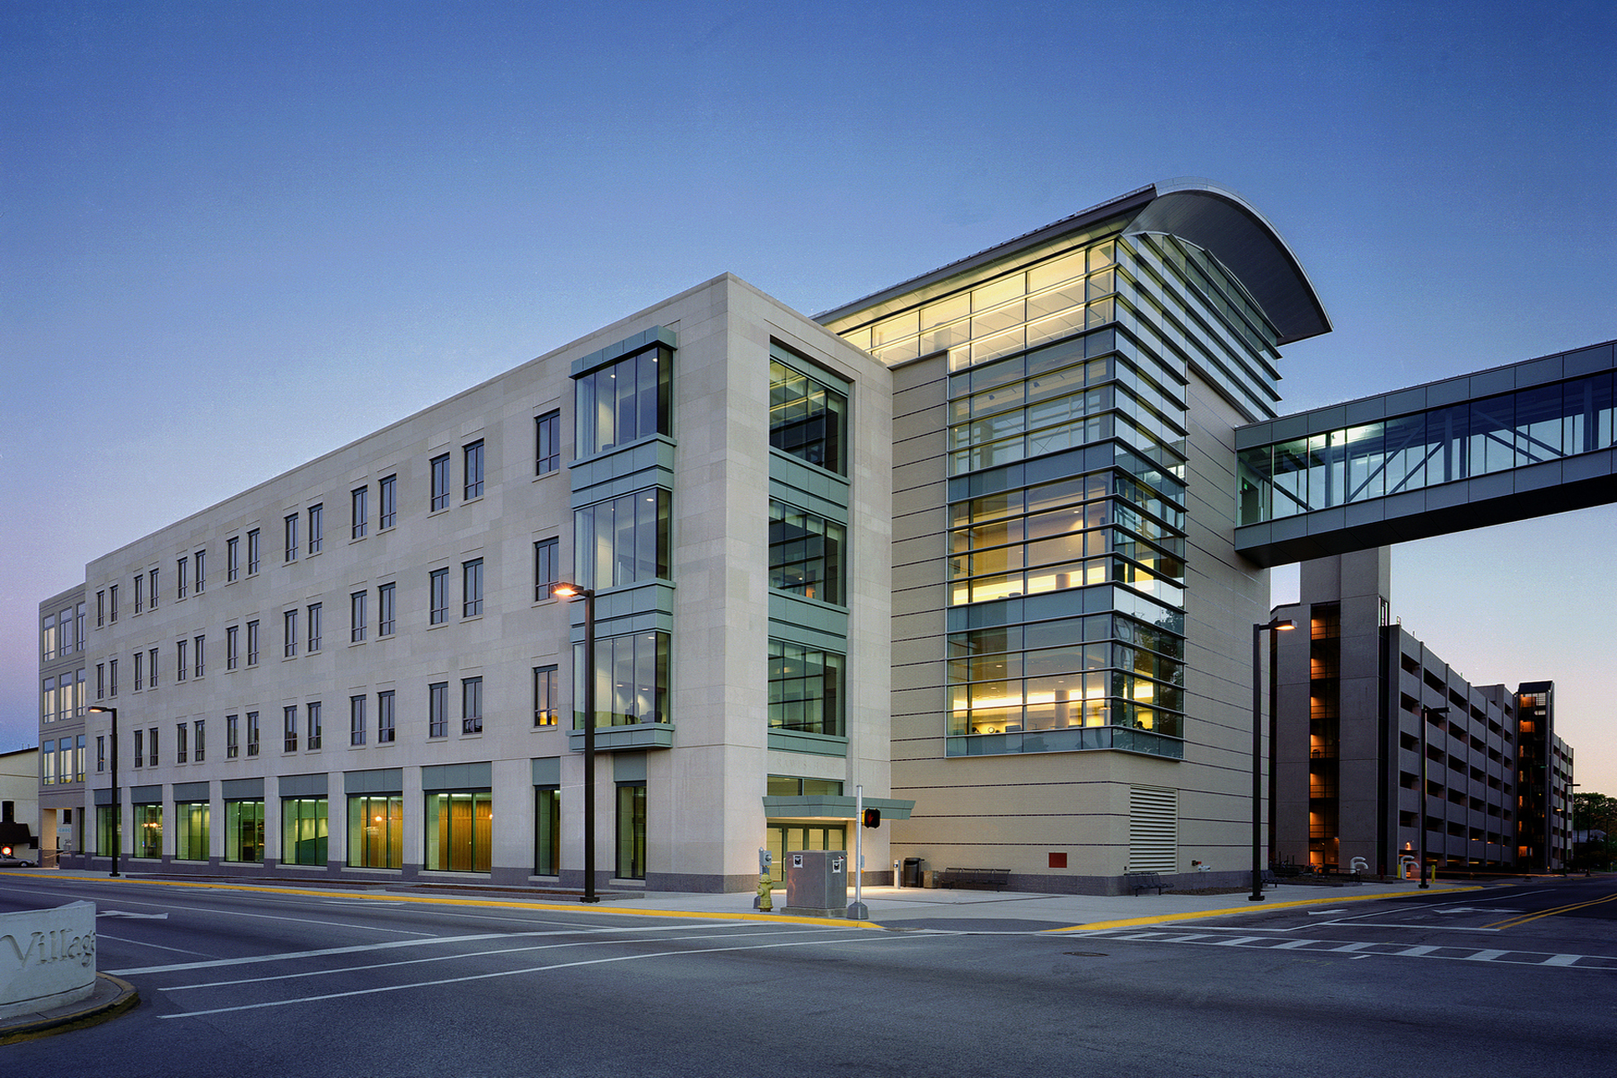
Emergency Shelter Design Summary
New Horizons
IDE 485-2015 Spring

Slide 2

Group Members
Who We ARE
Frank Blubaugh
Jian Ruan
General Engineering
Computer Science
Acoustical Engineering
Alison Dunlop
Joseph Hu
General Engineering
Chemistry
Visual Design Engineering
Product Lifecycle Management

Slide 3

Introduction
Previous Design
Costly
Generic
Vaguely Defined Target
Approximately $6500
Heavy
Hard to Assemble Without Machinery

Slide 4


Introduction
Introduction
Interim
Disaster Housing
Affordability
Easy to Assemble

Slide 5
Introduction
Overview
Joe
Frank
Alison
Market Viability
Technical Execution
Cost
Efficiency
Effective Design

Slide 6
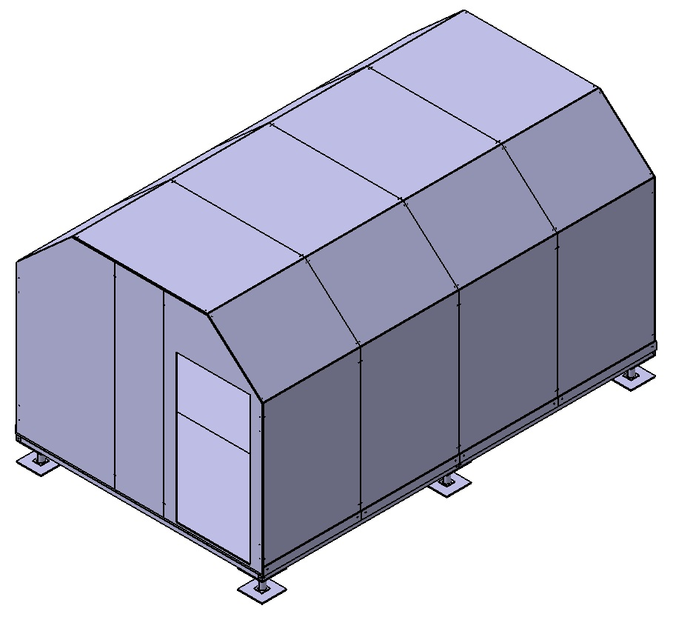
Introduction
Our Answer
Family shelter
Anyone Can Build It
Less Expensive
More Space

Slide 7
Market
Viability
Over $15 billion in disaster damage to homes per year:
Fire, hurricane, tornado, and flooding
$100 Million FEMA spending (2013) on emergency shelter annually
FEMA Hurricane Shelter Spending:
$5,000,000 after Sandy
$2.7 billion after Katrina

Slide 8
Market
Viability
Market Needs:
Interim housing (6-12 month deployment)
Intended Users are 4 person families in the United States
Low cost, rapid distribution
Possible Customers:
Distributed by Red Cross, state & local relief agencies
Secondary Uses
insurance companies
Temporary homeless shelters during winter months
International disaster/refugee relief

Slide 9
Utility
Overview
160 square feet
Insulated and Spacious for 12 month habitation
Dimensions:
10’ (w) x 16’(l) x 8’(h-max)
Accommodates a Family of Four
Limited Site Prep

Slide 10
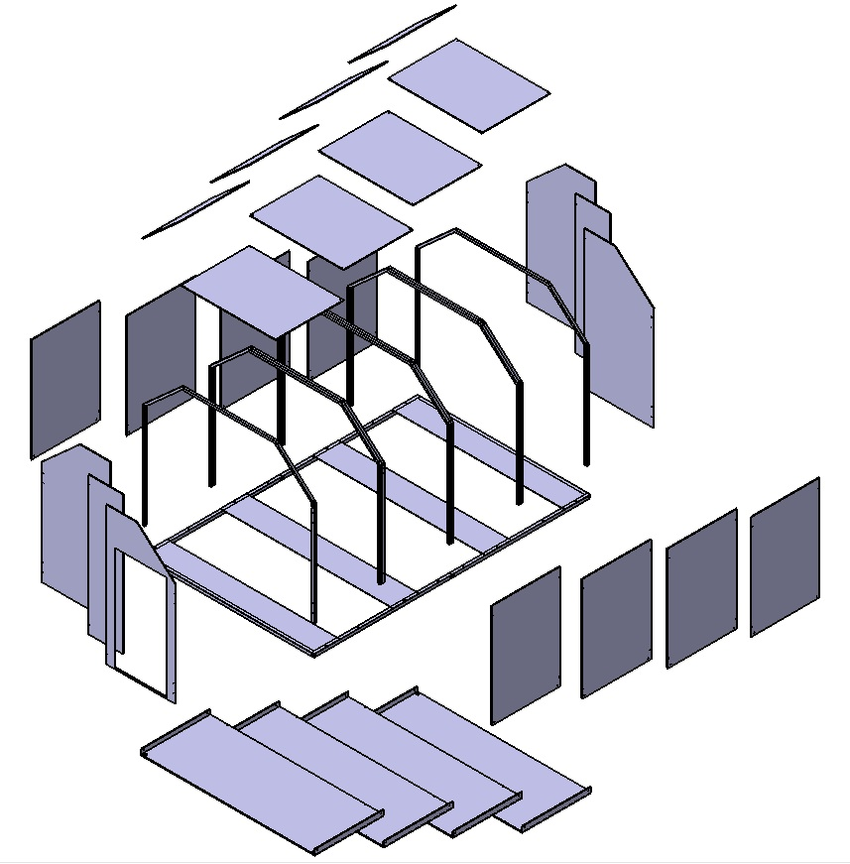
Utility
Doing it by the Numbers
25% increase in livable space
Maintained Shipping Volume (~96 cubic feet)
Reduced weight by ~10%
Decreased Cost by ~20%
Captioned Picture Pointing out these Features
Notes:
Increased the shelter living space to a 10’x16’ layout with a modular pattern of construction
Shipping Volume is roughly 8’x8’x3’ (compared to 8’x16x’1.5’)
Shipping shape could be broken into 3 different containers for more packing efficiency as well
Our initial calculations indicate that our shelter will produce roughly a 10% decrease in the overall weight reducing materials and shipping costs

Slide 11
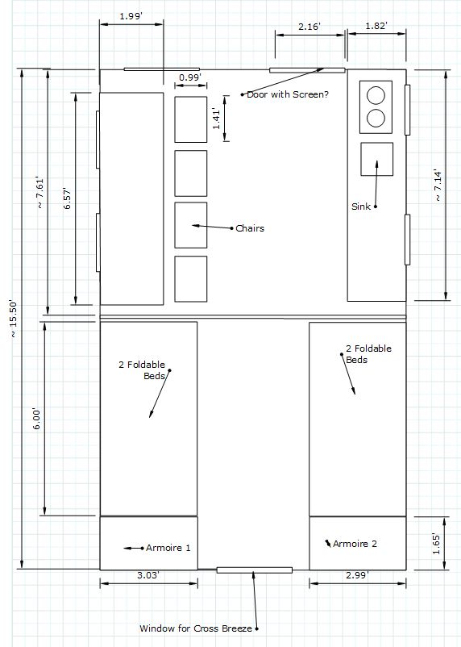
Utility
Focus on the Families
Buildable by families in a disaster recovery situation
Key Factors
No Special Training or Equipment
Longer Construction time
Assumptions about the intended family unit of use
Minimum 2 Able Bodied Adults
Maximum component weight of 100 lbs per unit
Expandable in 8’ units
Notes:
Key Elements of our design:
The only “Heavy” Equipment needed is removing the shelter components from the truck (“Theoretical Push Off”)
Simplicity of Assembly means anyone can do it
Design Challenges of this approach
Maximum component weight
Simplicity, how can you make it an intuitive assembly
Limitations of our design
No Plumbing Facilities require External Support (Codes etc made this implausible)

Slide 12

Utility
Safety First
Construction
Safety Factor
Unique Assembly, No High lifting
No Power Tools
Personal Safety
Living
Flame Resistant Construction
Easy to Sanitize
Insulation and limited climate control
Security
Notes:
Key Elements of our design:
The only “Heavy” Equipment needed is removing the shelter components from the truck (“Theoretical Push Off”)
Simplicity of Assembly means anyone can do it
Design Challenges of this approach
Maximum component weight
Simplicity, how can you make it an intuitive assembly
Limitations of our design
No Plumbing Facilities require External Support (Codes etc made this implausible)

Slide 13
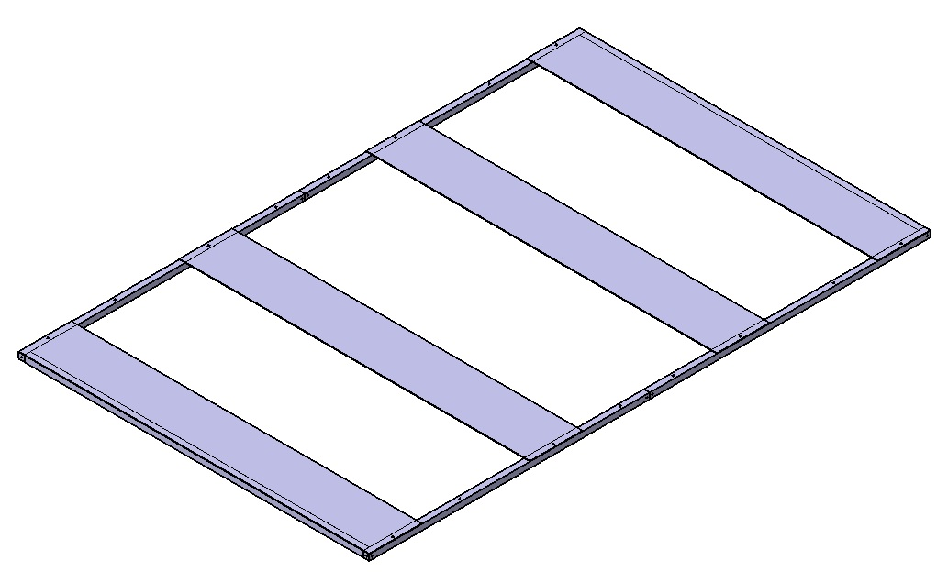
Utility
Assembly Process
Notes:
Add the Floor Supports

Slide 14
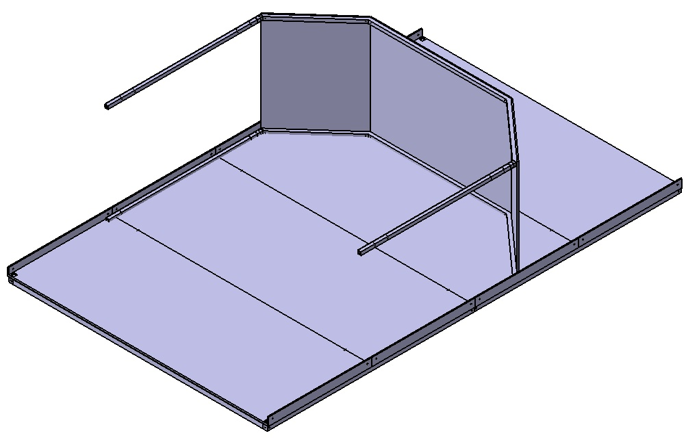
Utility
Assembly Process
Notes:
Add the Floor

Slide 15
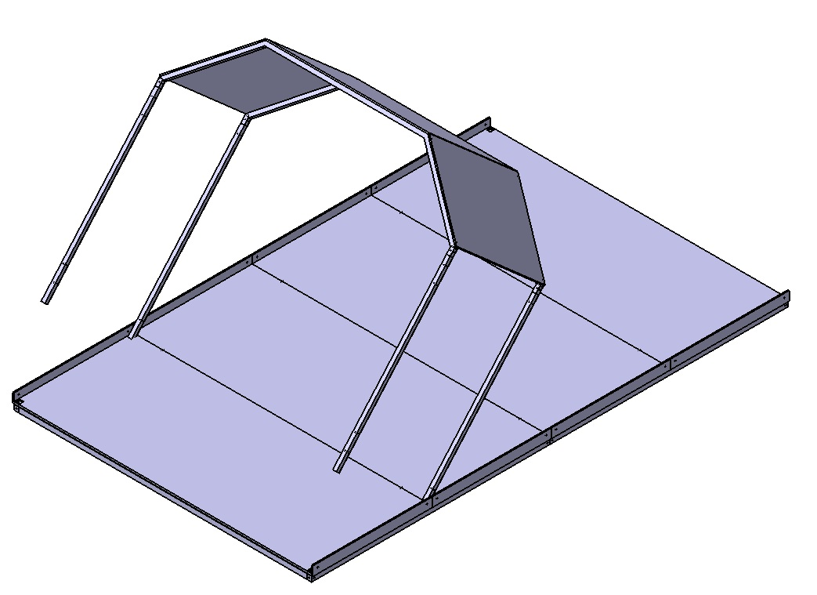
Utility
Assembly Process
Notes:
Add the Floor

Slide 16
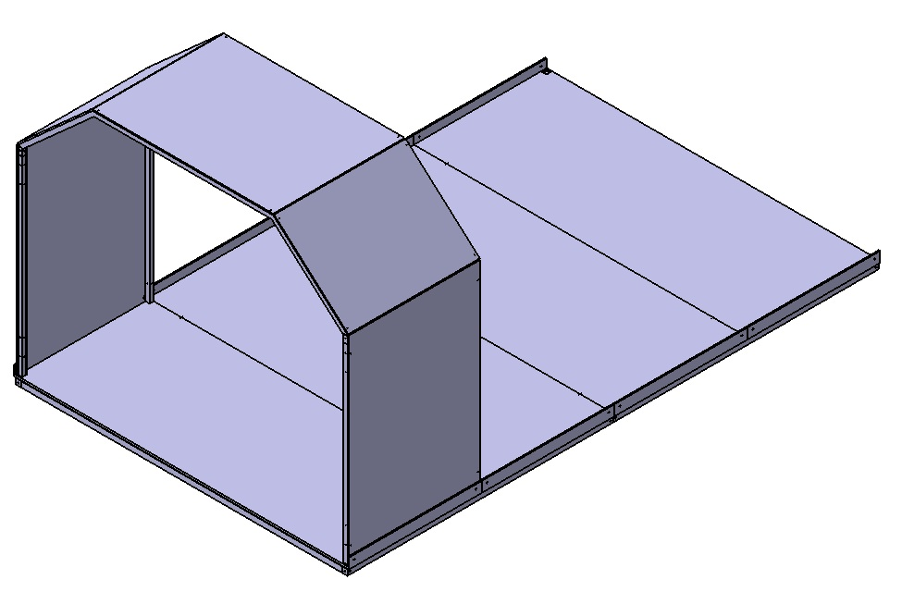
Utility
Assembly Process
Notes:
Repeat this process and add notes for the

Slide 17
Utility
Fully Assembled Mock-Up

Slide 18
Overview
Affordability
Group Members
Total Cost: $5,087

Slide 19
Affordability
Empty Shelter Cost Estimate
Wall :
Panels $670.56
Panel Support $409.92
Total Wall: $1080.48
Floor:
6 Jacks $288.00
Deck $352.00
+Frame Work $370.28
Total Floor: $1010.28
Roof:
Panels $252.67
Bracing $322.78
Total Roof: $575.45
Empty Shelter:
Wall $1080.48
Floor $1010.28
Roof $ 575.45
Extra + $565.18
Total Empty Shelter $3231.39

Slide 20
Affordability
Amenity Cost Estimate
Utilities:
Sink System $134
HVAC $250
4 LED Lights $48
Power Source $88
2Burner Stovetop $85
Total Utilities $605
Security:
Alarms $17
Door $193
Deadbolt $15
Safe $60
Total Security $285
Furniture:
Dining Table Set $113
2 Armoires $269
4 Beds $436
Kitchenette $103
Privacy Curtain $45
Total Furniture $966
Total Amenities: $1,856

Slide 21
Affordability
Total Cost Estimate
Shelter Total Cost Estimate
+
=
$3,231
$1,856
$5,087

Slide 22
Summary
Emergency Shelter
Four Person Family
Two Person Assembly
$5,087
$100 Million Market
25% Larger

Slide 23

Thank you

Slide 24
(Backup) Marketability
Number of People
11,400
# People after 3 months
2,850
3 Month Housing Cost |  |  | 3 Month Housing Cost |  |  | Δ
$5,130,000 |  |  | $4,631,250 |  |  | $498,750
Cost per Person |  |  | Cost Per Person
$1,800 |  |  | $1,625 |  |  | +175
Cost per Shelter |  |  | Cost Per Shelter
$7,200 |  |  | $6,500 |  |  | -700

